Slide 2
Acne Vulgaris
Of 3, chose 2: GDS2478, GDS3218

Slide 3
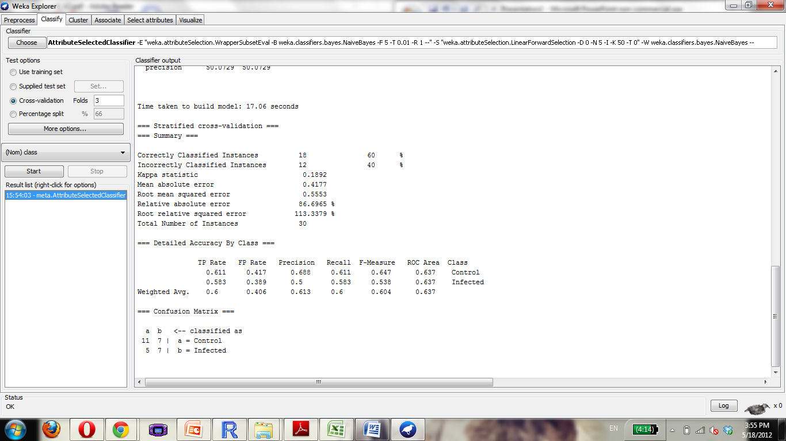

Slide 4


Slide 5
Alzheimer disease
Of 13, only chose the following: GDS2795, GDS2601, GDS1491, GDS811, GDS810, GDS809, GDS519, GDS1979

Slide 6
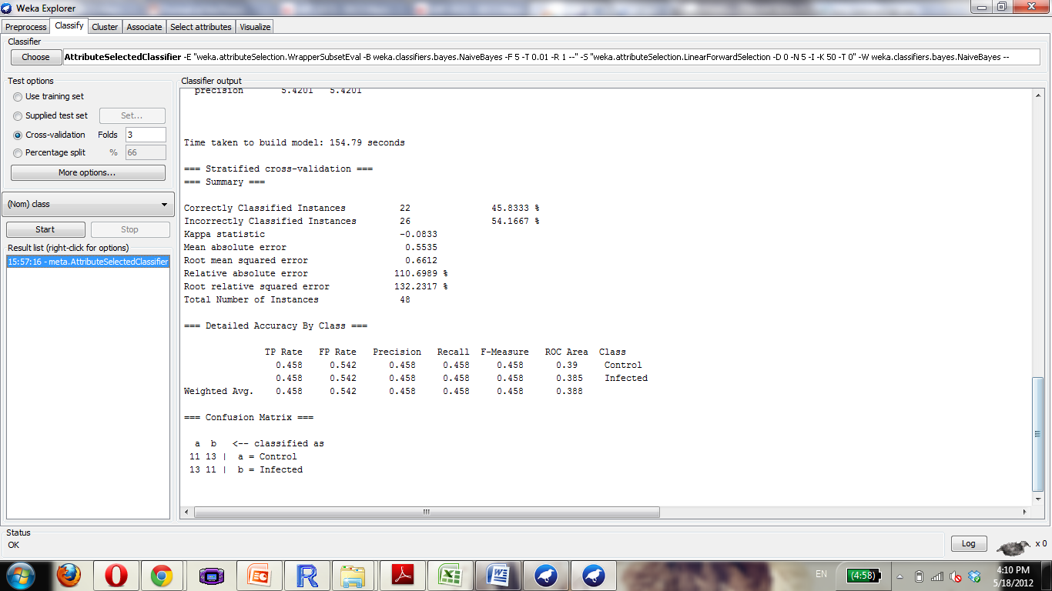

Slide 7
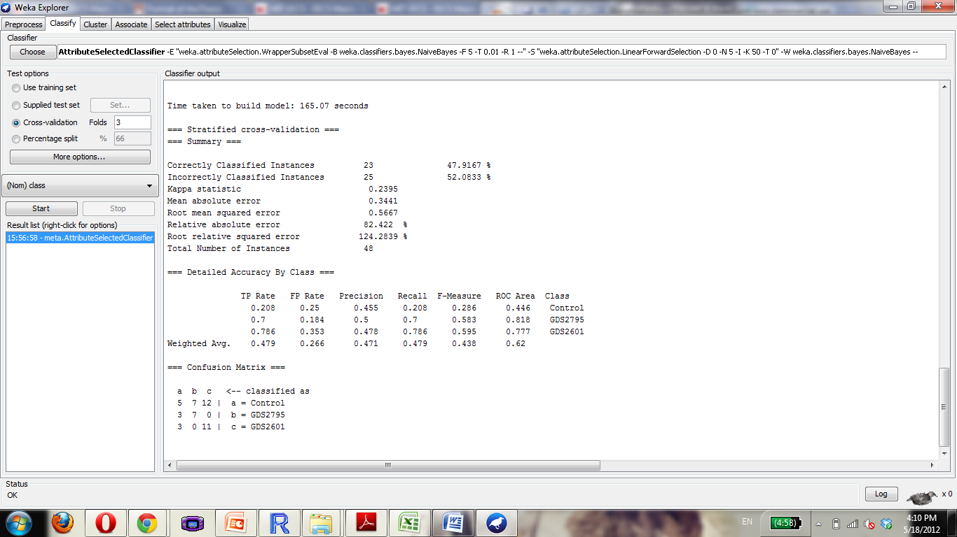

Slide 8
Anemia
Of 10: GDS3576, GDS3405, GDS3268, GDS2118, GDS2073, GDS1700, GDS1392

Slide 9


Slide 10
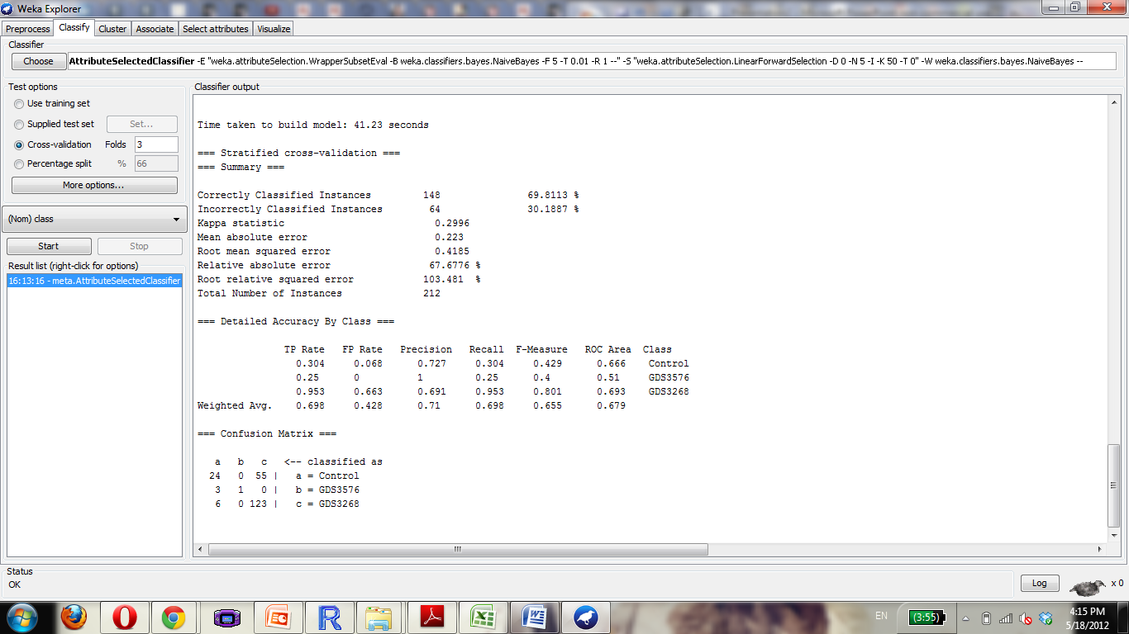

Slide 11
Aortic Aneurysm
5
GDS2960, GDS2922, GDS2838

Slide 12
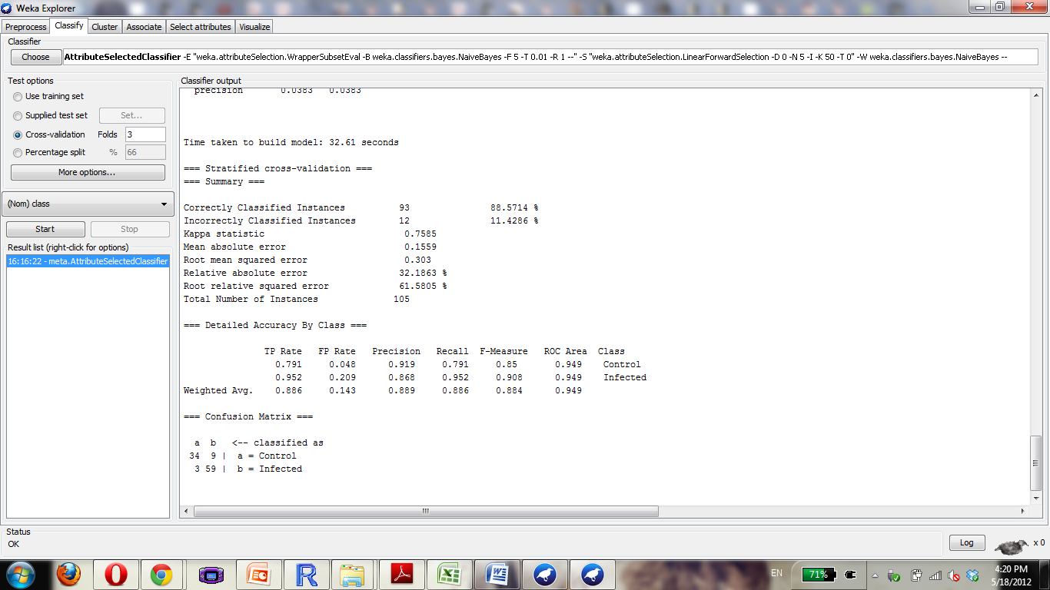

Slide 13
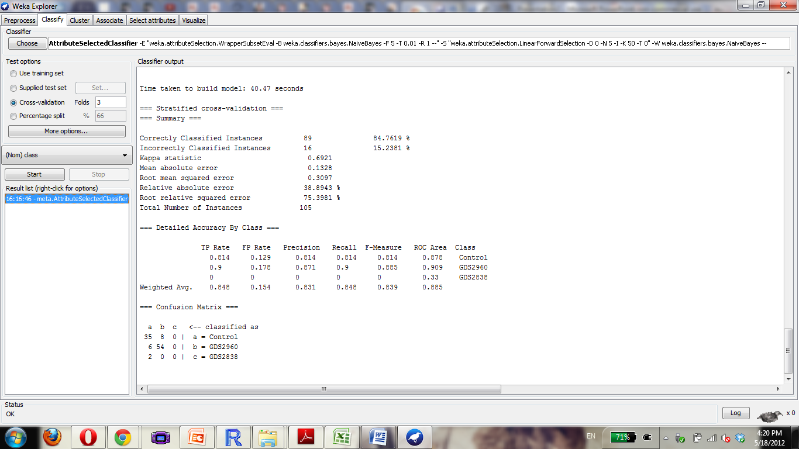

Slide 14
Rheumatoid Arthritis
14
GDS3628, GDS3203, GDS3192, GDS3158, GDS2952, GDS2931, GDS2885, GDS2126, GDS1857, GDS711

Slide 15
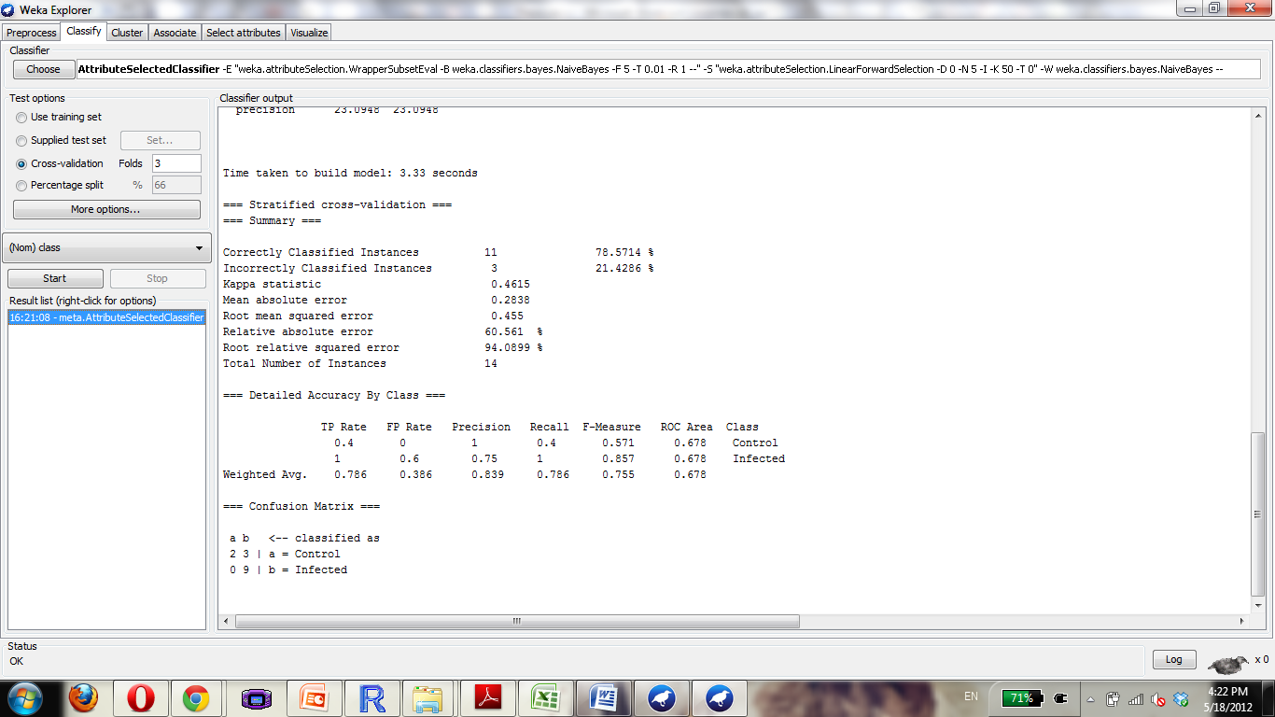

Slide 16
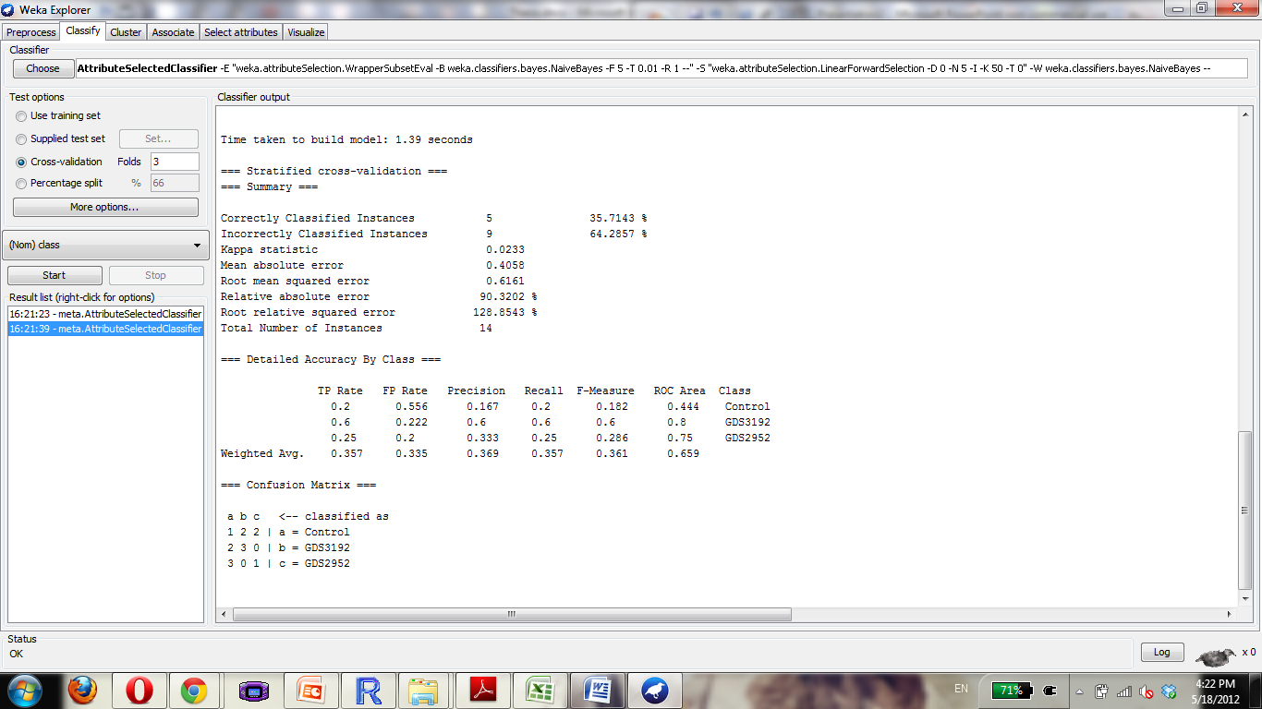

Slide 17
Asthma
28 possible. Using:
GDS3711, GDS3615, GDS3573, GDS3268, GDS3073, GDS2976, GDS2852, GDS2628, GDS1985, GDS1520, GDS1269, GDS266, GDS261, GDS245, GDS240, GDS60

Slide 18


Slide 19
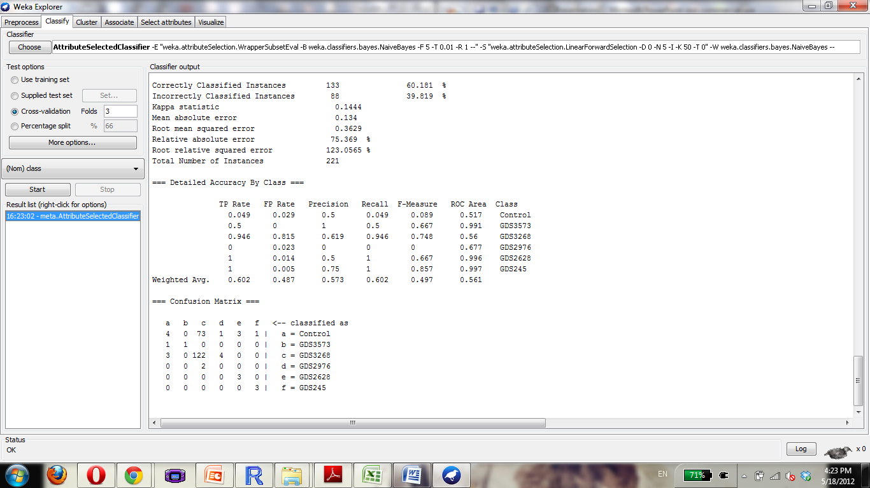

Slide 20
Atherosclerosis
28 Available, choose
GDS2303, GDS2889, GDS3413, GDS3671, GDS3686, GDS3696, GDS3697, GDS3698, GDS3203

Slide 21


Slide 22
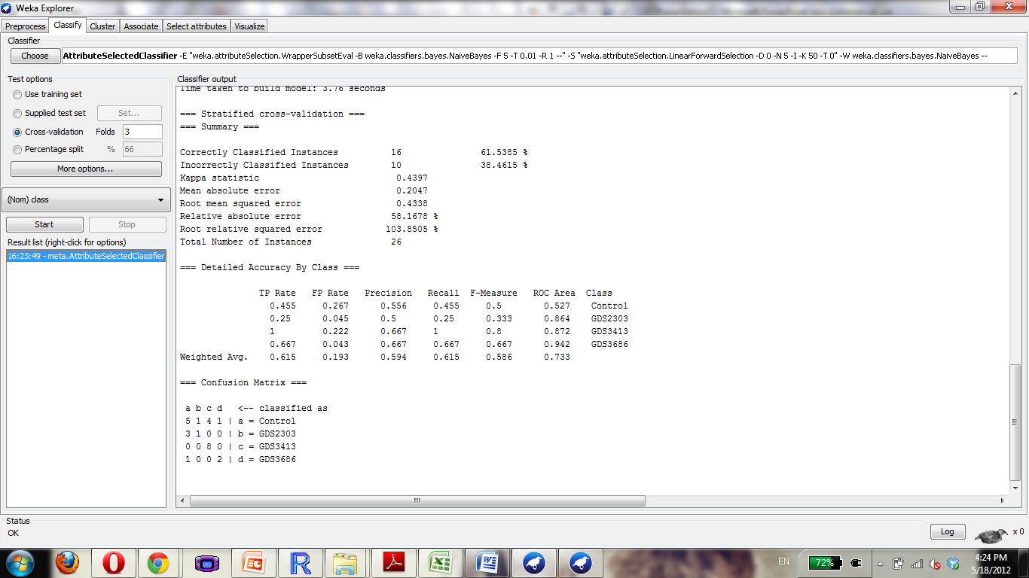

Slide 23
Bipolar Disorder
Of 4 choose 3: GDS2190, GDS2191, GDS2779

Slide 24
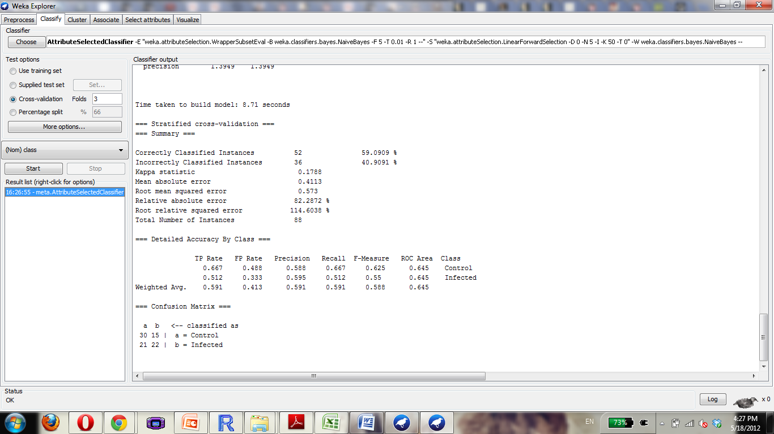

Slide 25
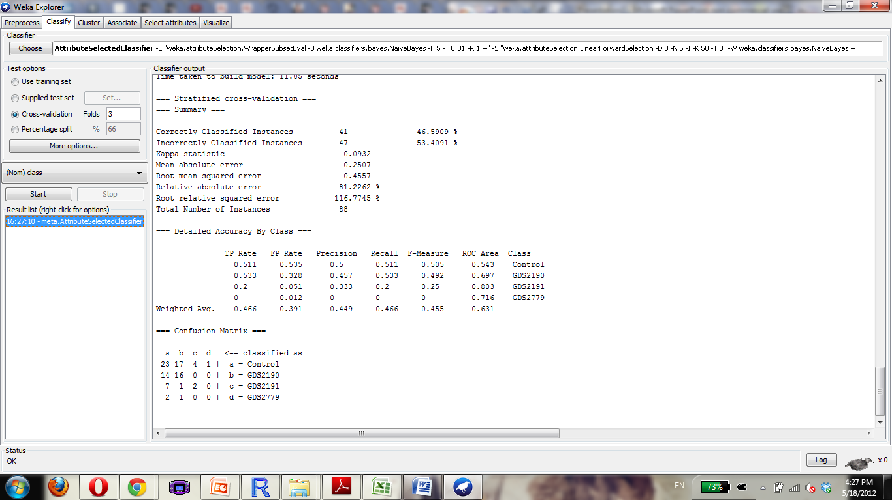

Slide 26
Carcinoma, Squamous Cell
Of 18:
GDS2958, GDS2732, GDS2520, GDS2373, GDS2088, GDS2087, GDS2086, GDS1667, GDS1584, GDS1062

Slide 27


Slide 28
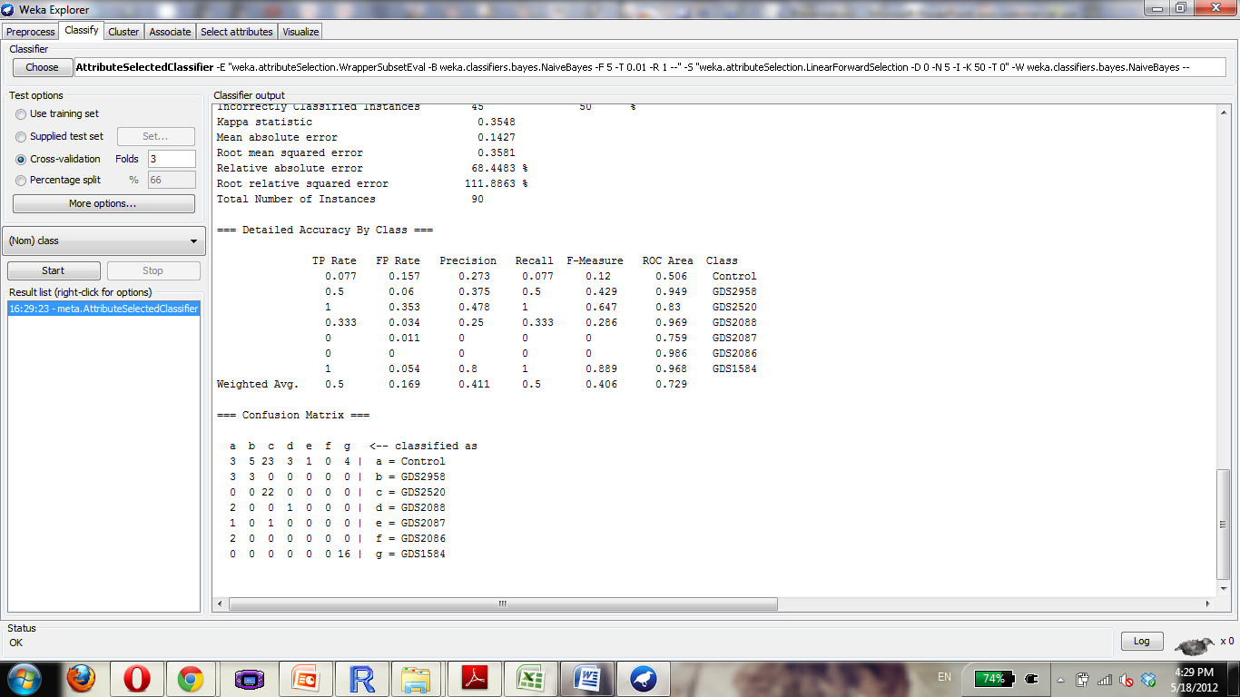

Slide 29
Cardiomyopathy
Of 28, choose:
GDS3698, GDS3697, GDS3696, GDS3660, GDS3115, GDS3018, GDS2884, GDS2746, GDS2206, GDS2205, GDS651, GDS213

Slide 30
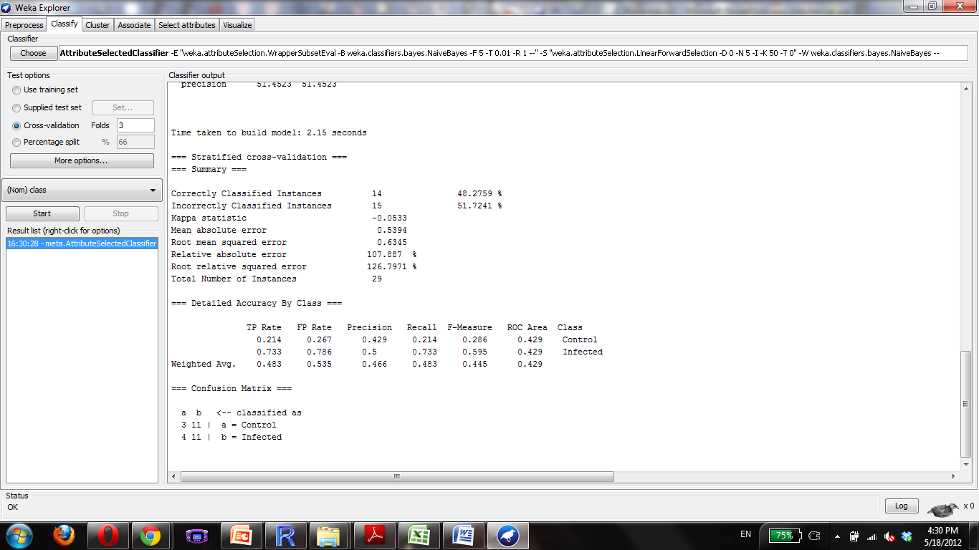

Slide 31
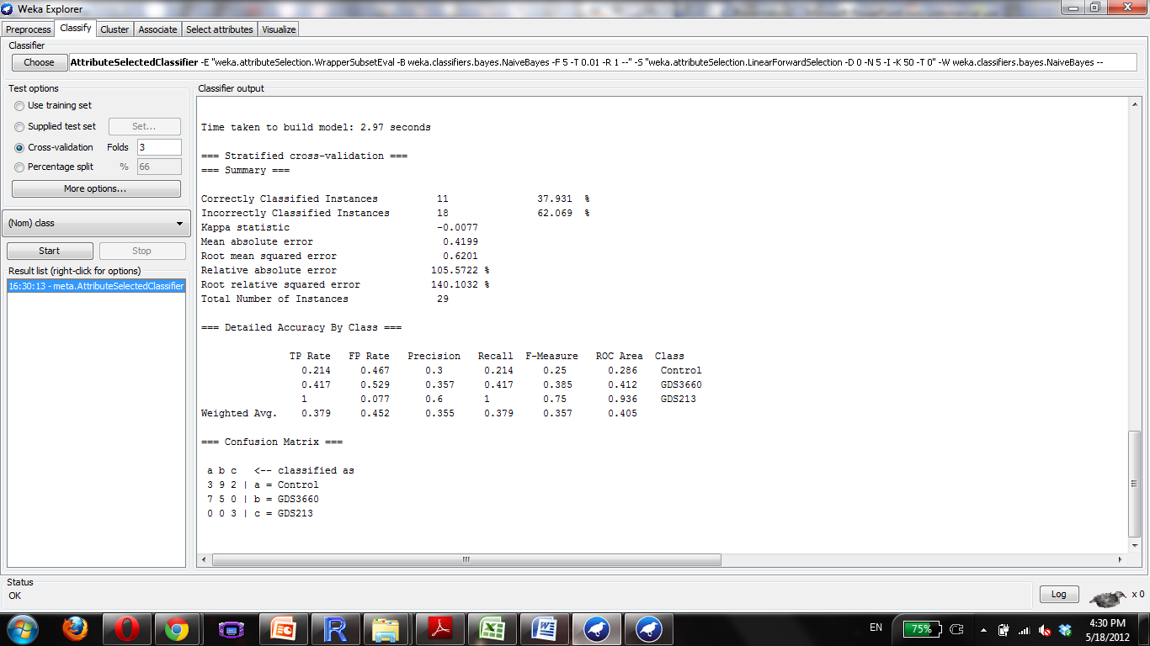

Slide 32
Colitis
Of 14, GDS3323, GDS3119, GDS2014, GDS1871, GDS1478

Slide 33
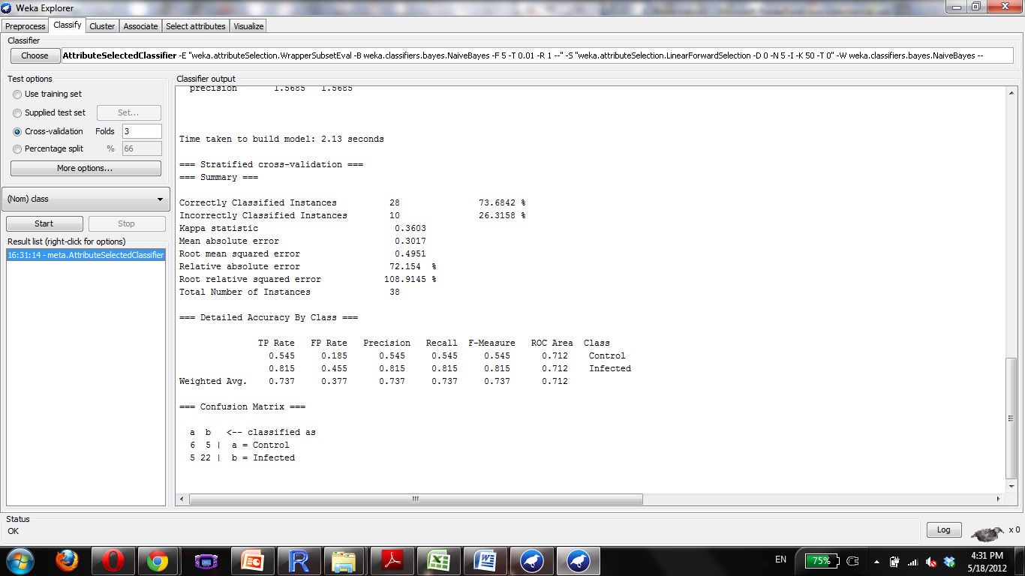

Slide 34
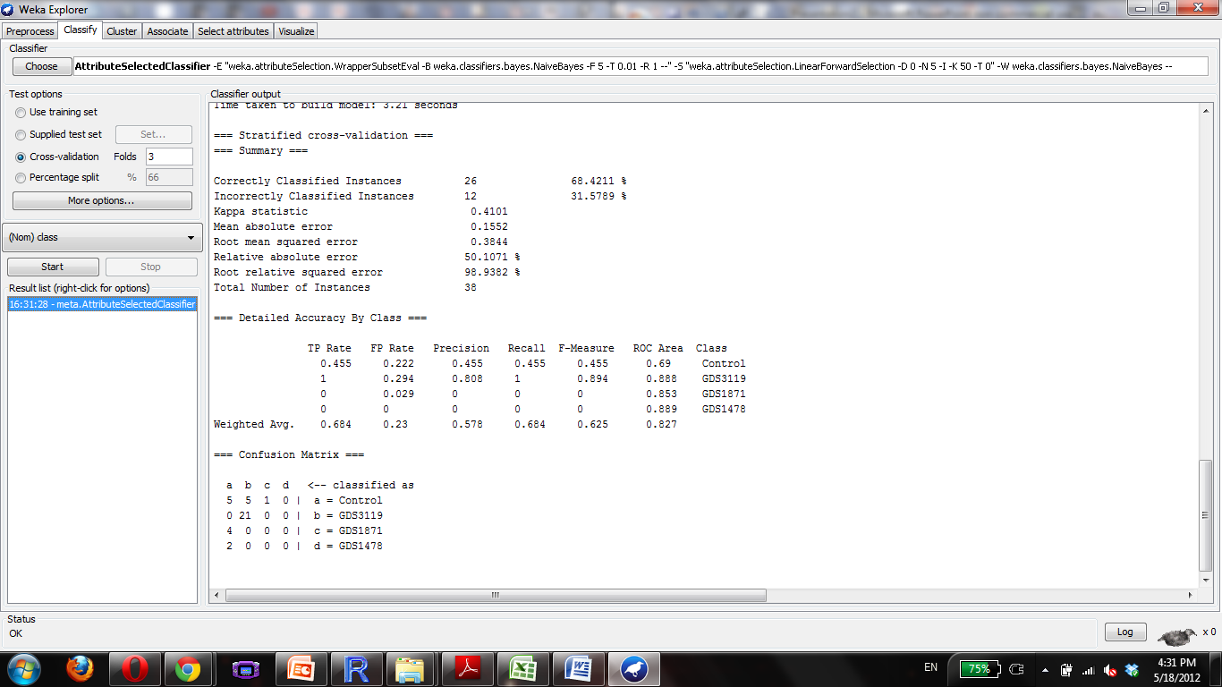

Slide 35
Dermatitis
4
GDS2935, GDS2820, GDs2381, GDS2382,

Slide 36
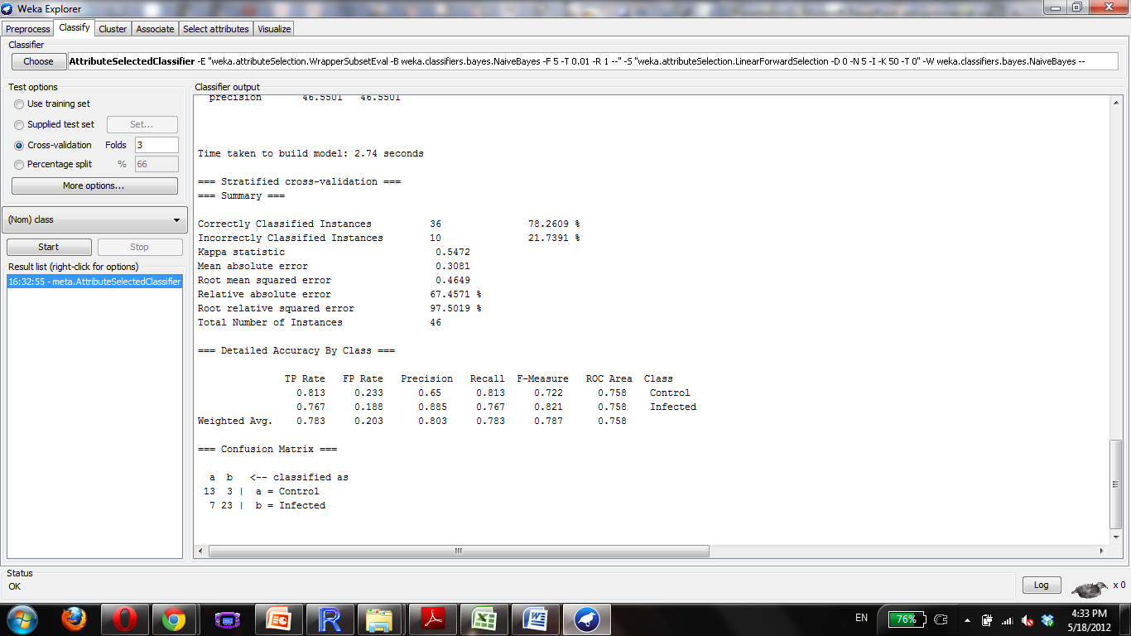

Slide 37
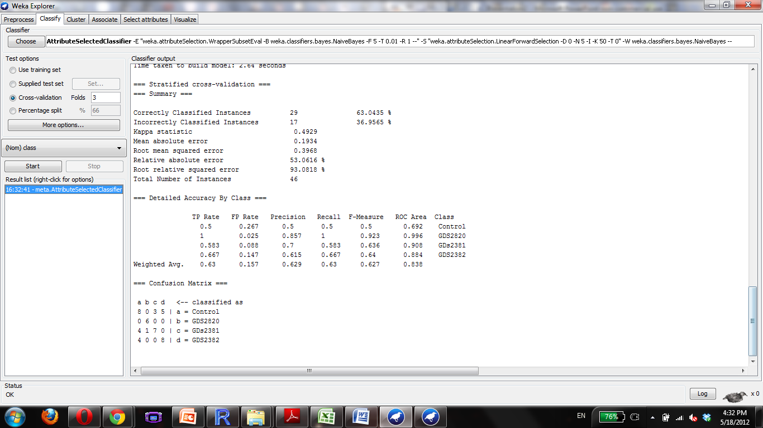

Slide 38
Diabetes
Has 70 , come back to this later
GDS3715, GDS3695, GDS3687, GDS3682, GDS3681, GDS3665, GDS3658, GDS3657, GDS3656, GDS3653, GDS3647, GDS3396, GDS3347, GDS3181, GDS3153, GDS3104, GDS3001, GDS2945, GDS2791, GDS2790, GDS2742, GDS2610, GDS2605, GDS2335, GDS2289, GDS2179, GDS2178, GDS2177, GDS2132, GDS1913, GDS1883, GDS1767, GDS1541, GDS1533, GDS1474, GDS1473, GDS1456, GDS1444, GDS1443, GDS1393, GDS1225, GDS1056, GDS961, GDS905, GDS887, GDS734, GDS784, GDS402, GDS162, GDS161, GDS160, GDS157, GDS10
53/70

Slide 39
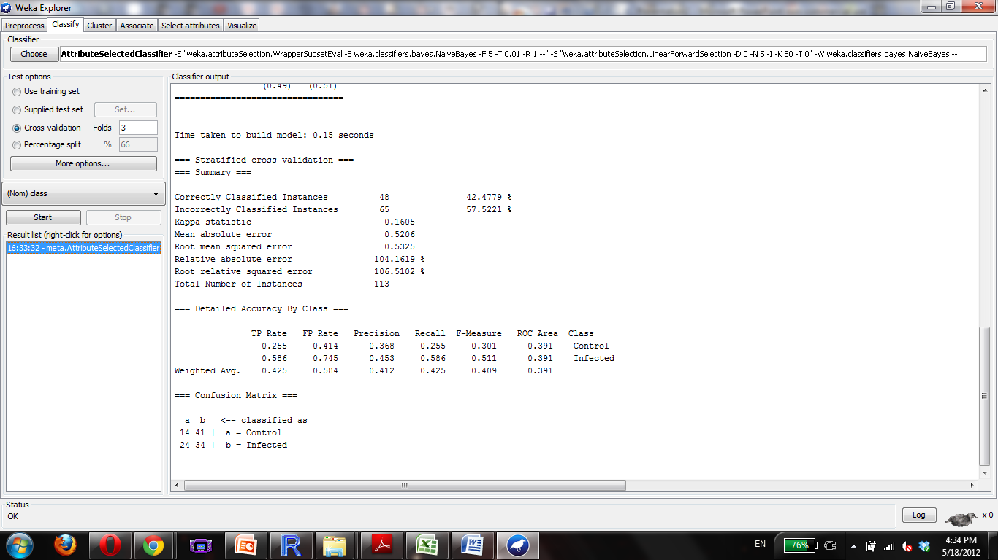

Slide 40
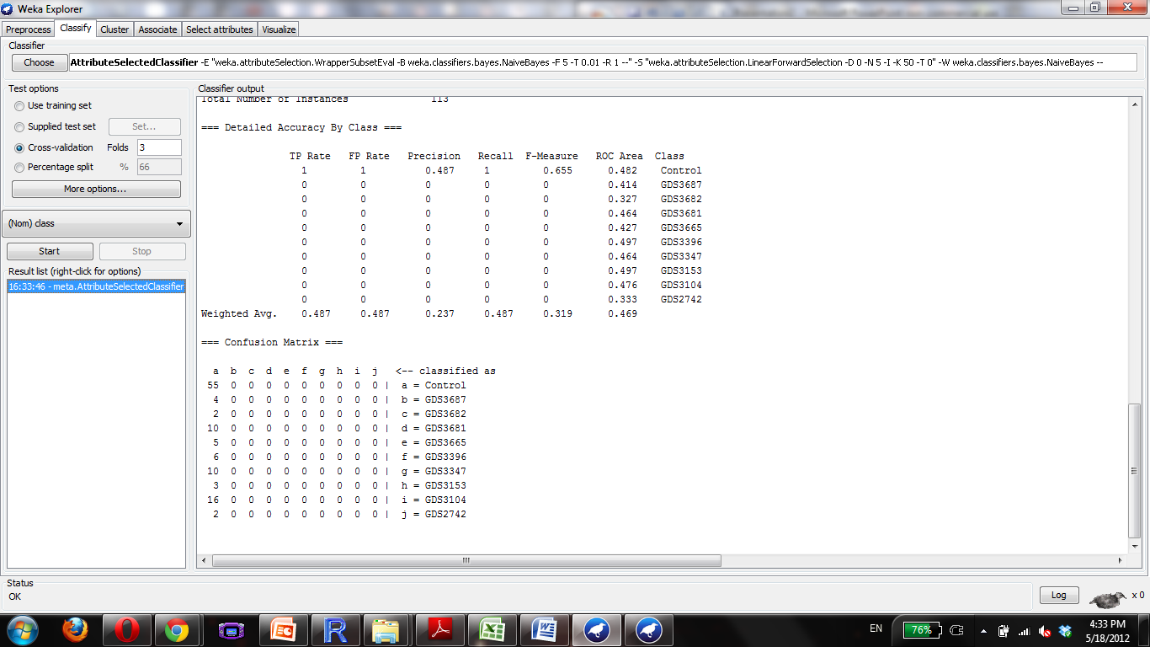

Slide 41
Endometriosis
6 choose
GDS3092, GDS3060, GDS2835, GDS2737, GDS2052,

Slide 42


Slide 43


Slide 44
Epilepsy
9,
GDS1745, GDS1626, GDS1051, GDS1050, GDS1018, GDS954

Slide 45


Slide 46


Slide 47
Fibrosis
49
GDS1252, GDS1313, GDS1492, GDS1810, GDS1941, GDS2142, GDS2143, GDS2292, GDS2316, GDS2361, GDS2817, GDS2869, GDS2893, GDS3071, GDS3174, GDS3251, GDS3393, GDS3552, GDS387, GDS388, GDS493, GDS567, GDS588, GDS858

Slide 48


Slide 49
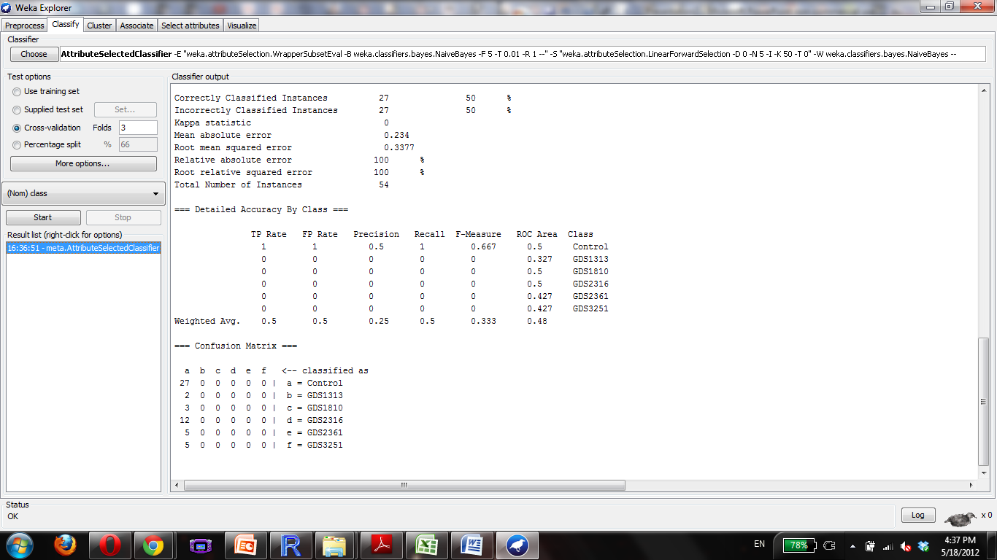

Slide 50
Glaucoma
7
GDS2892, GDS1728, GDS1313, GDS1112, GDS359

Slide 51


Slide 52
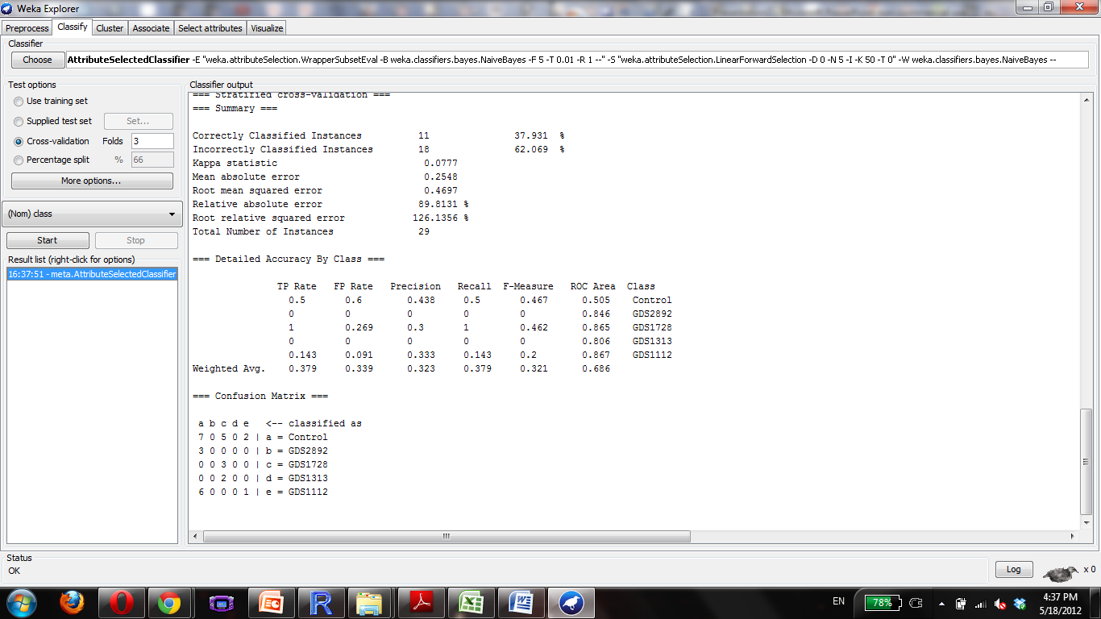

Slide 53
Heart Disease
14
GDS3663, GDS3659, GDS3623, GDS3600, GDS3594, GDS3573, GDS3513, GDS2316, GDS385, GDS384, GDS50, GDS49

Slide 54


Slide 55
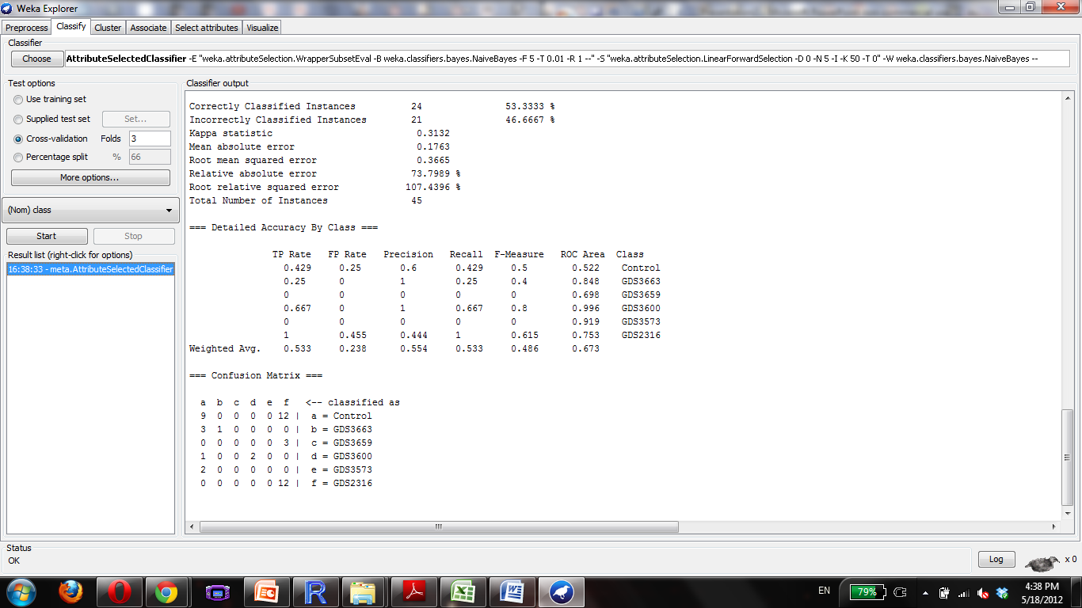

Slide 56
HIV
19
GDS3511, GDS2920, GDS2883, GDS2649, GDS2187, GDS2168, GDS2164, GDS1875, GDS1726, GDS1646, GDS1449, GDS1397, GDS1063, GDS708, GDS171

Slide 57


Slide 58
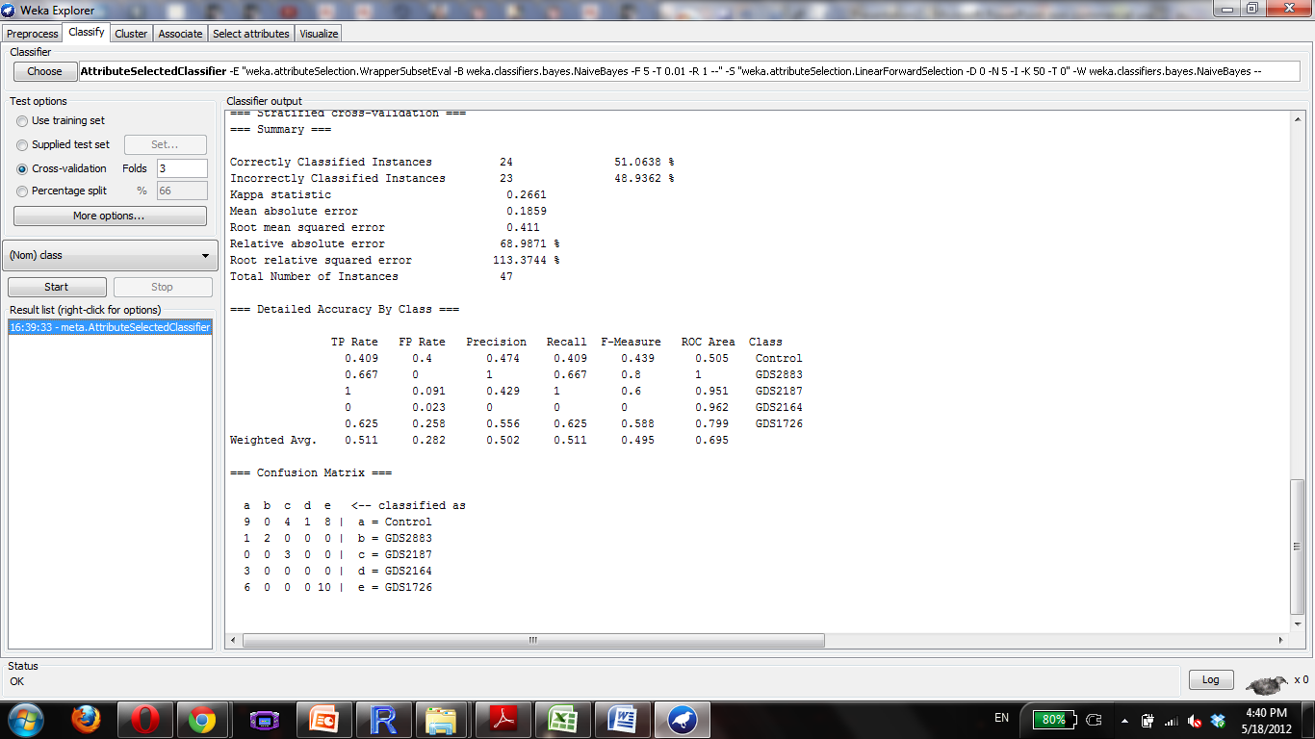

Slide 59
Huntington Disease
14
GDS3621, GDS3620, GDS3515, GDS3178, GDS2912, GDS2887, GDS1332, GDS1331

Slide 60


Slide 61


Slide 62
Hypertrophy
45
GDS3637, GDS3596, GDS3552, GDS3551, GDS3465, GDS3117, GDS3134, GDS3018, GDS2316, GDS2308, GDS2304, GDS2258, GDS2172, GDS2134, GDS1928, GDS1892, GDS1264, GDS1049, GDS902, GDS794, GDS742, GDS696, GDS654, GDS598, GDS446, GDS278, GDS252, GDS144, GDS61, GDS59

Slide 63


Slide 64
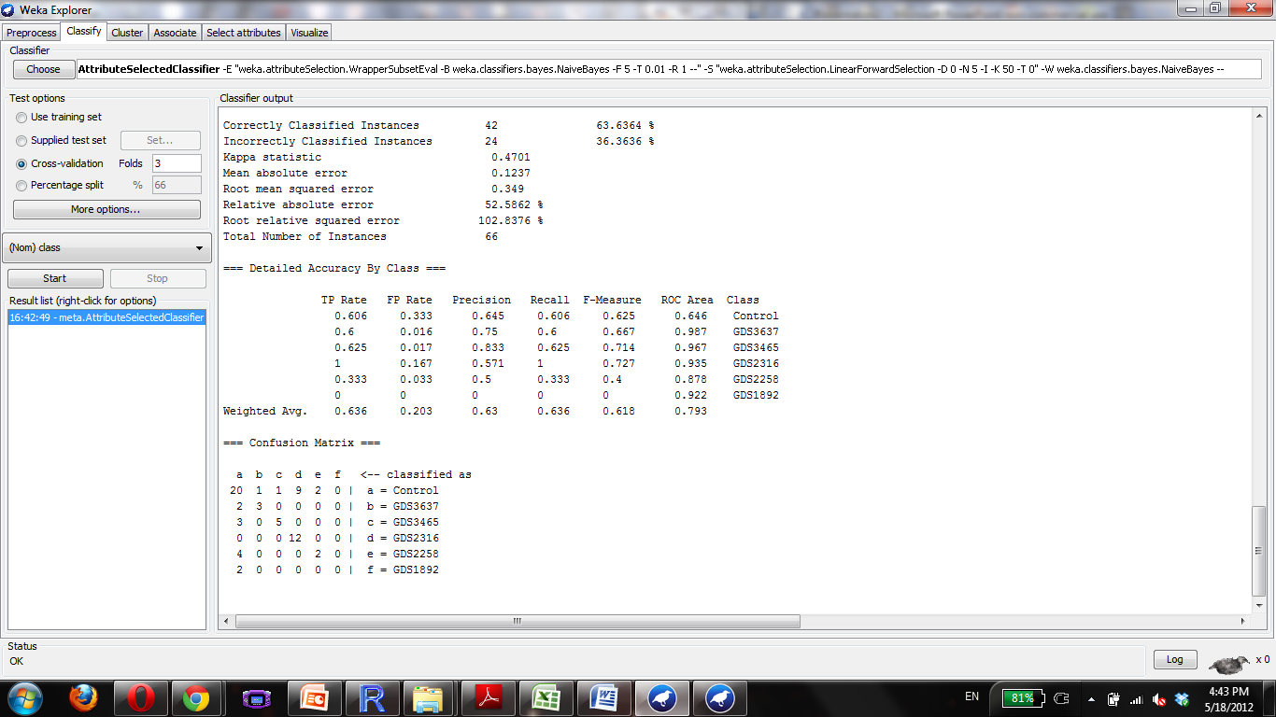

Slide 65
Hypoxia
55
GDS3660, GDS3524, GDS3521, GDS3483, GDS3438, GDS3114, GDS3112, GDS2951, GDS2902, GDS2891, GDS2761, GDS2760, GDS2759, GDS2758, GDS2750, GDS2466, GDS2457, GDS2425, GDS2248, GDS2218, GDS2162, GDS2161, GDS2160, GDS2036, GDS2018, GDS1968, GDS1807, GDS1783, GDS1779, GDS1772, GDS1648, GDS1450, GDS1379, GDS1213, GDS1209, GDS710, GDS366, GDS272, GDS252, GDS246, GDS61, GDS59

Slide 66


Slide 67
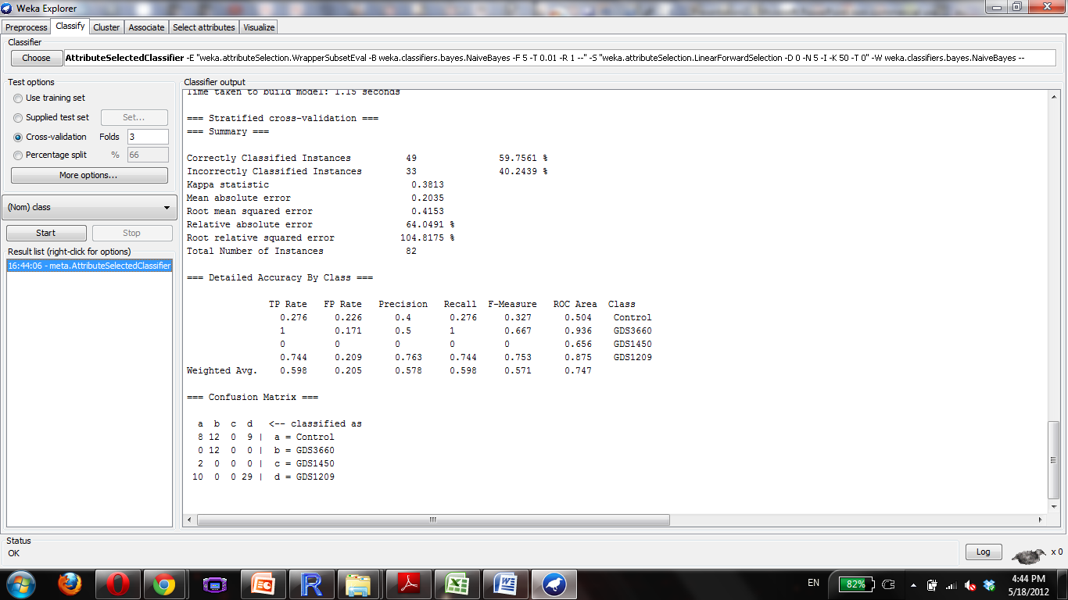

Slide 68
Inflammation
113
GDS3602, GDS3601, GDS3580, GDS3539, GDS3522, GDS3431, GDS3417, GDS3268, GDS3223, GDS3193, GDS3192, GDS3119, GDS3109, GDS3088, GDS2931, GDS2889, GDS2858, GDS2822, GDS2858, GDS2822, GDS2651, GDS2487, GDS2484, GDS2478, GDS2382, GDS2381, GDS2255, GDS2104, GDS2070, GDS2023, GDS1520, GDS1498, GDS1497, GDS1496, GDS1495, GDS1481, GDS1480, GDS1328, GDS1311, GDS1276, GDS1256, GDS1239, GDS1032, GDS962, GDS882, GDS625, GDS599, GDS567, GDS436, GDS435, GDS433, GDS251,
52/113

Slide 69
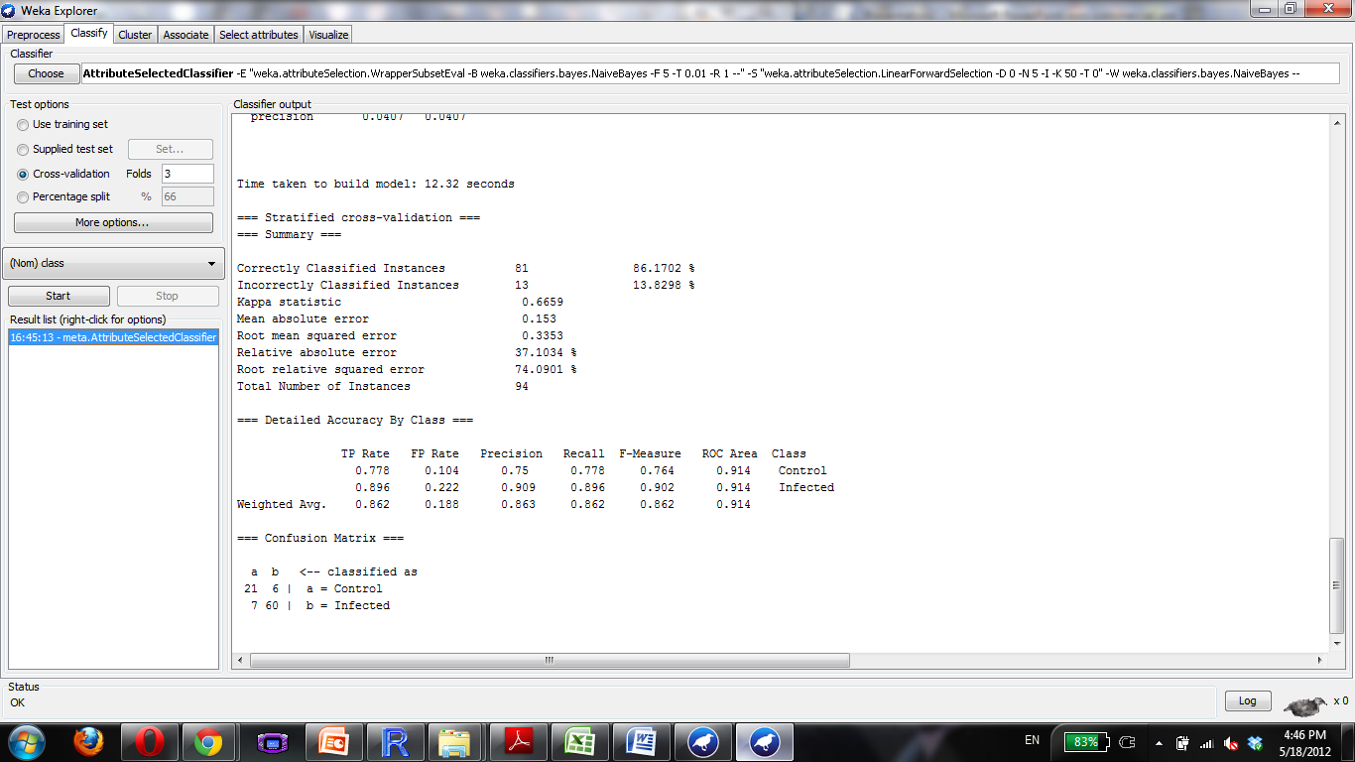

Slide 70
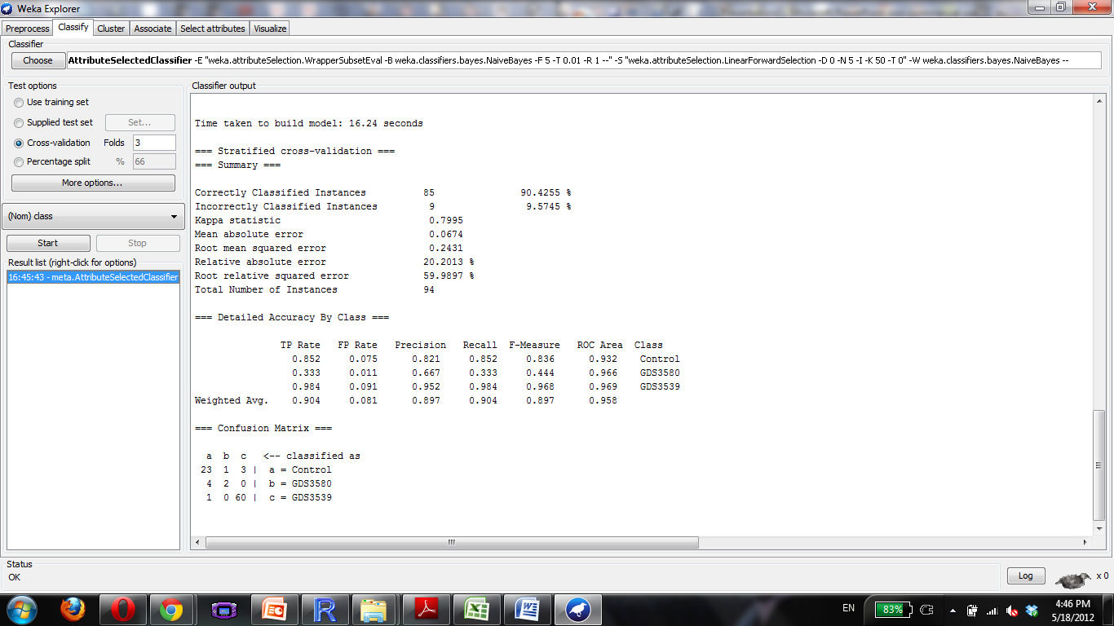

Slide 71
Ischemia
18
GDS3662, GDS3655, GDS2772, GDS2311, GDS2070, GDS1959, GDS1018, GDS1017, GDS808, GDS710

Slide 72
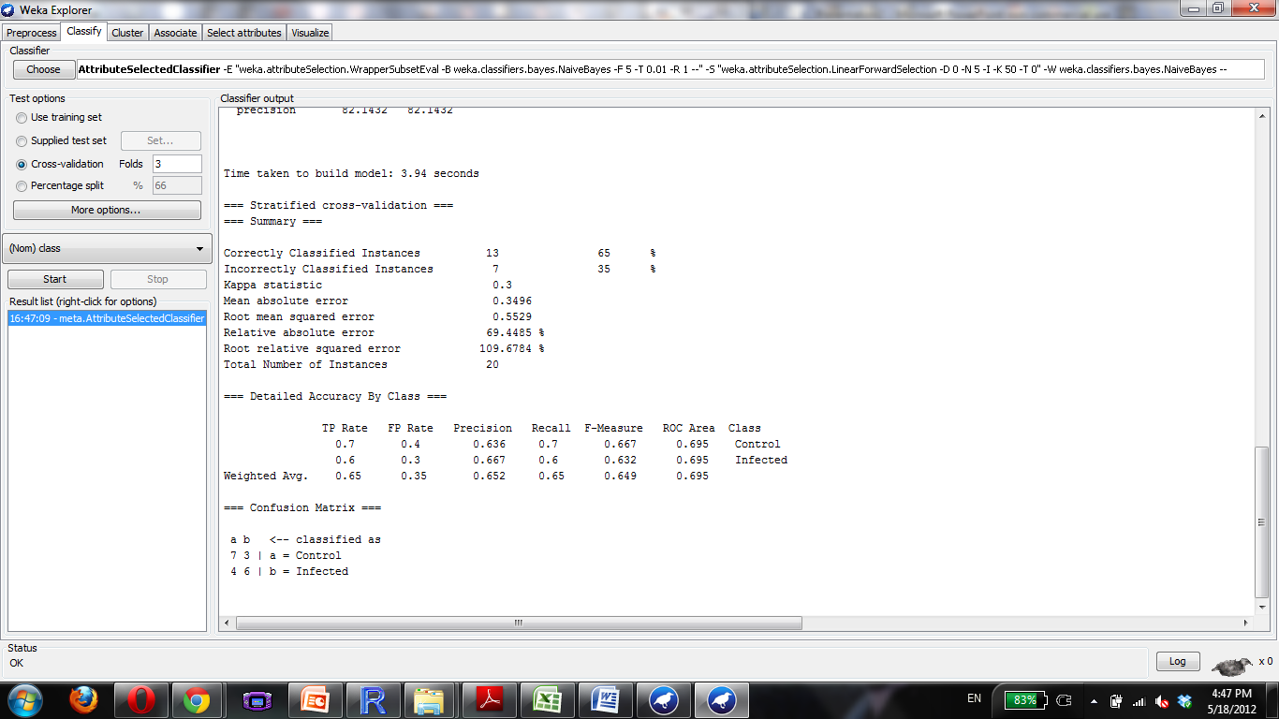

Slide 73
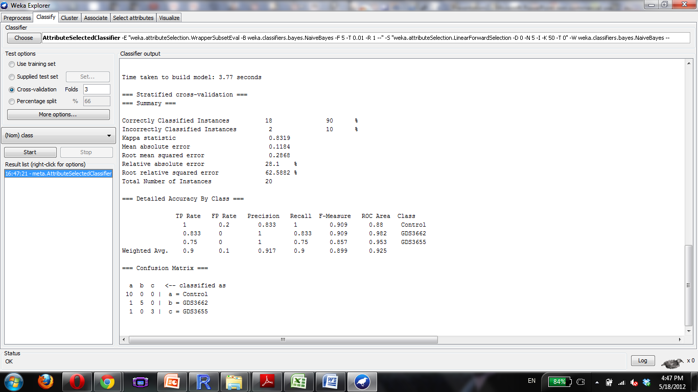

Slide 74
Leiomyoma
6
GDS2246, GDS2245, GDS1476, GDS533, GDS484

Slide 75
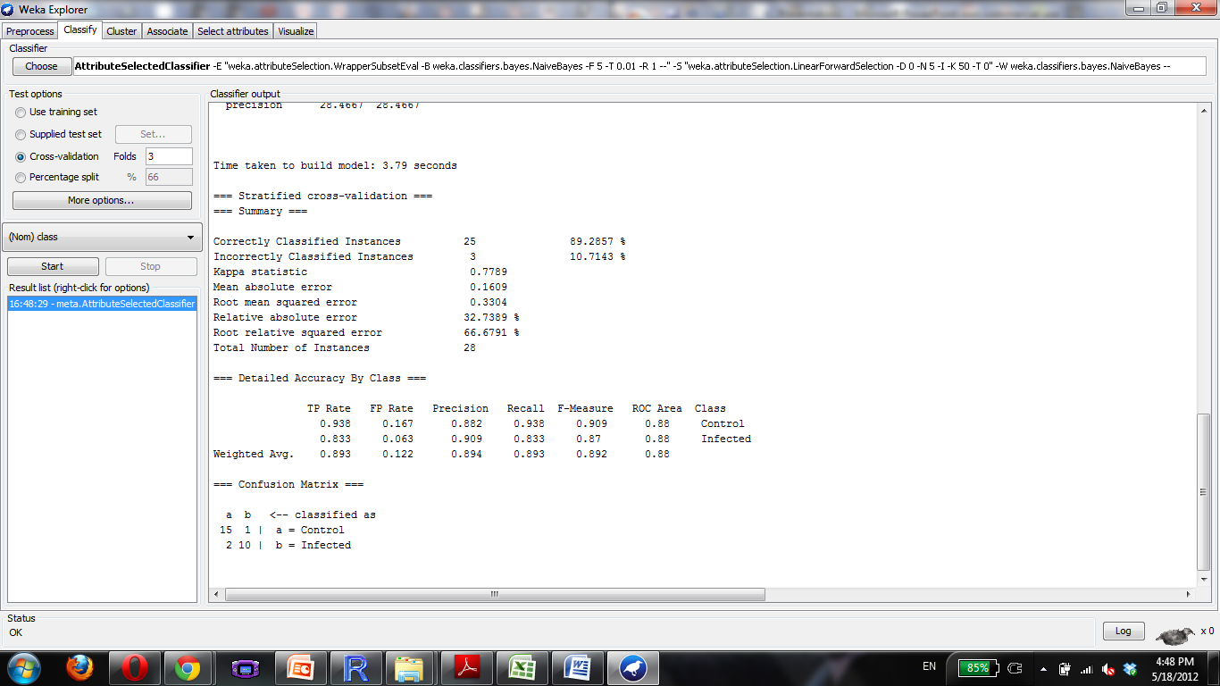

Slide 76
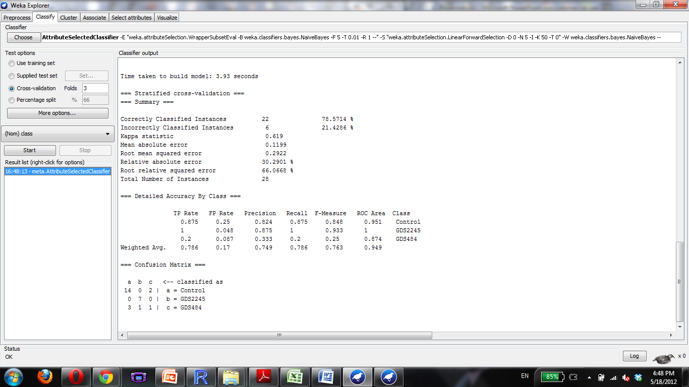

Slide 77
Lung Disease
27
GDS3705, GDS3496, GDS3483, GDS2604, GDS2486, GDS2372, GDS2188, GDS2143, GDS2142, GDS1941, GDS1673, GDS1436, GDS1304, GDS1255, GDS1252, GDS737, GDS534, GDS289, GDS251

Slide 78
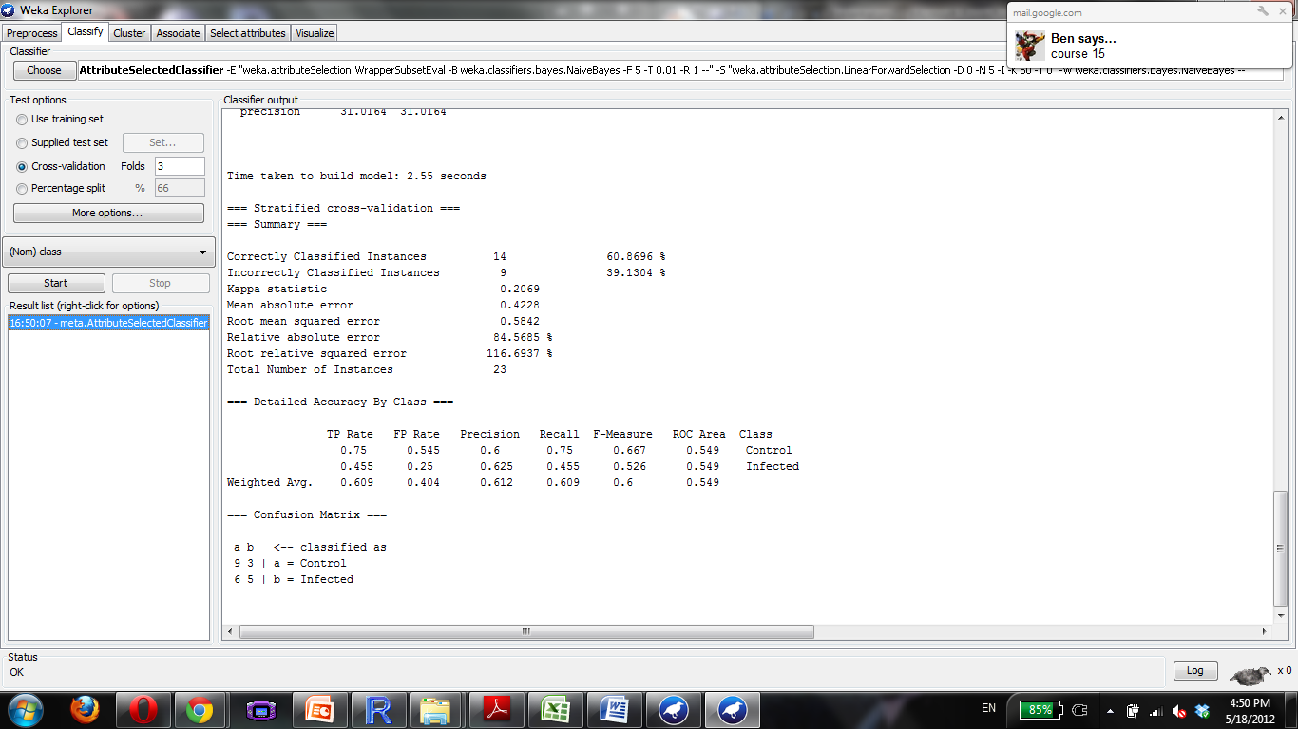

Slide 79
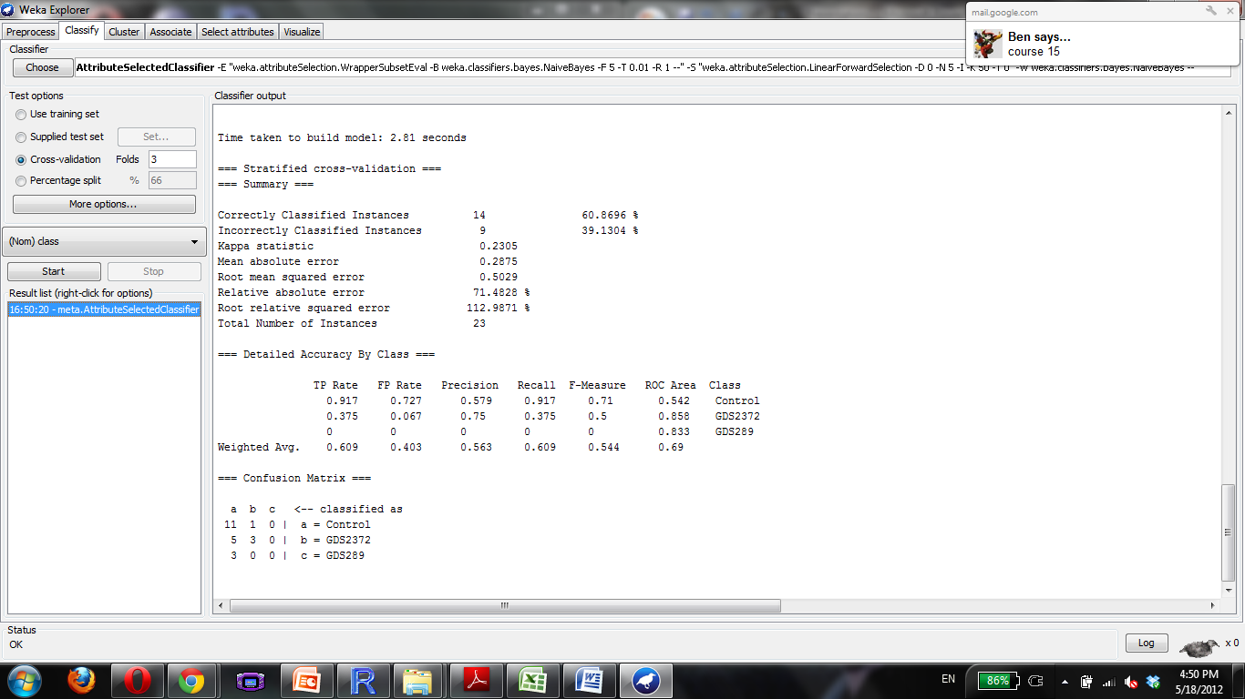

Slide 80
Lung Neoplasm
31
GDS3627, GDS3309, GDS3257, GDS3101, GDS3054, GDS2966, GDS2865, GDS2777, GDS2771, GDS2604, GDS2499, GDS2491, GDS2490, GDS2489, GDS2406, GDS2373, GDS2298, GDS2297, GDS1688, GDS1650, GDs1649, GDS1312, GDs1252, GDS1204, GDS737, GDS534
What the hell does down syndrome have to do w/ lung cancer?

Slide 81


Slide 82
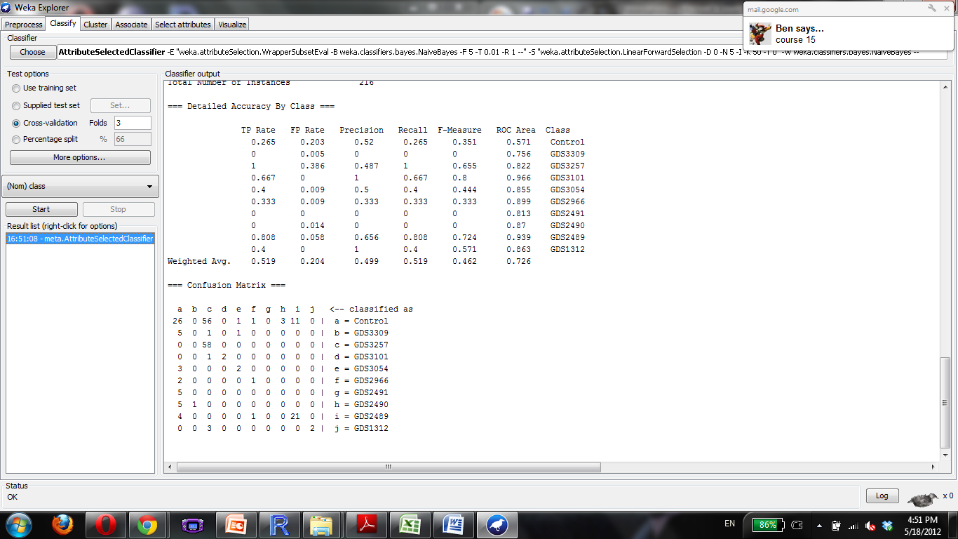

Slide 83
Lymphoma
35
GDS3516, GDS3291, GDS3147, GDS2988, GDS2908, GDS2554, GDS2295, GDS2042, GDS1960, GDS1839, GDS1807, GDS1750, GDS1617, GDS1419, GDS1409, GDS1063, GDS989, GDS988

Slide 84
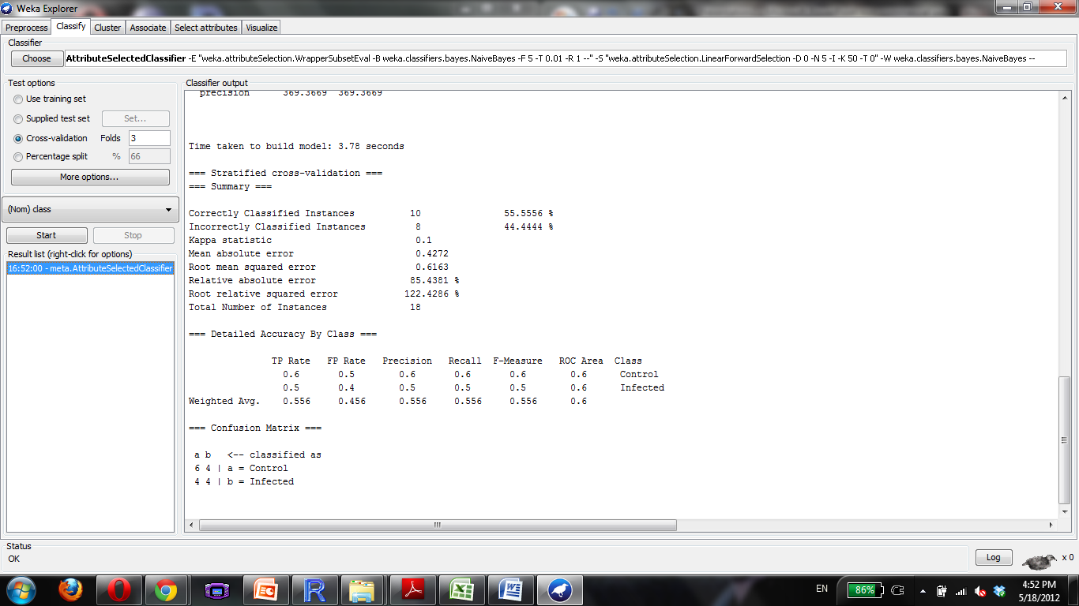

Slide 85
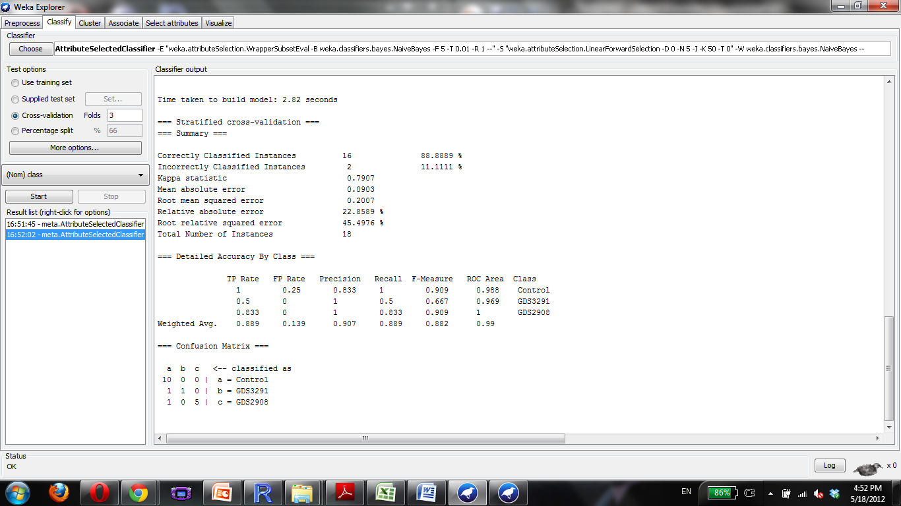

Slide 86
Melanoma
23
GDS3517, GDS3489, GDS3012, GDS2735, GDS2244, GDS2200, GDS1989, GDS1965, GDS1964, GDS1440, GDS1375, GDS1314, GDS1078

Slide 87
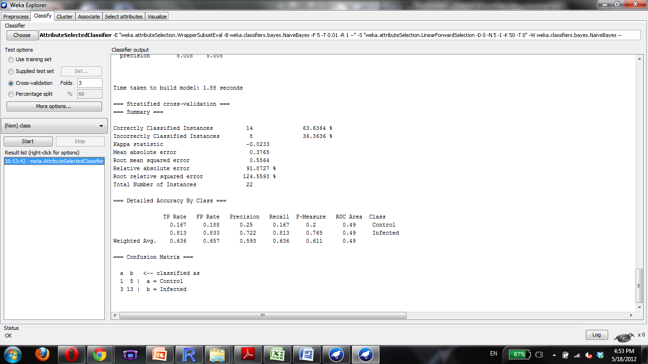

Slide 88
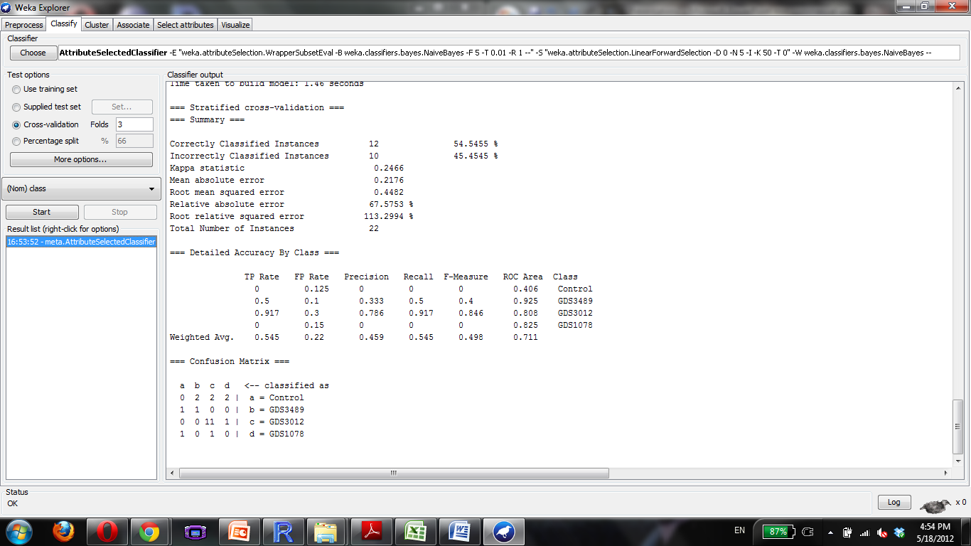

Slide 89
Mental Disorder
6
GDS3345, GDS2447, GDS2191, GDS2190,

Slide 90


Slide 91


Slide 92
Neoplasm
276

Slide 93
Neoplasm Metastasis
35
GDS3710, GDS3501, GDS3489, GDS3324, GDS3289, GDS3179, GDS3138, GDS3091, GDS2932, GDS2865, GDS2617, GDS2547, GDS2546, GDS2545, GDS2443, GDS1780, GDS1210, GDS1062, GDS756, GDS274, GDS232

Slide 94


Slide 95
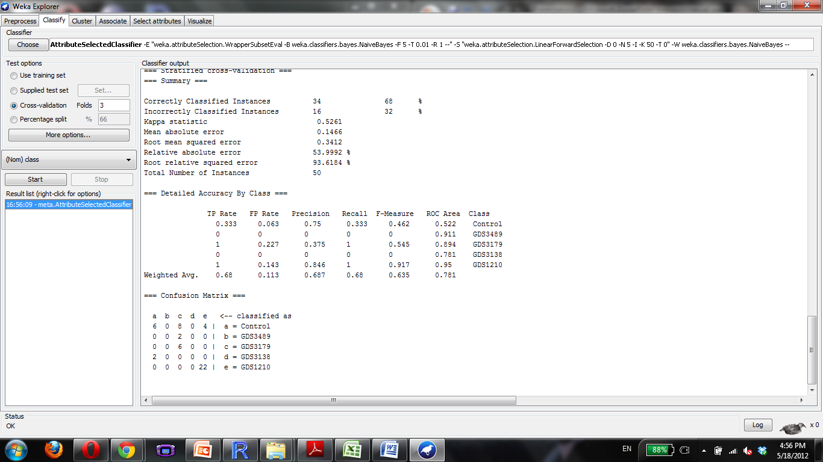

Slide 96
Neurodegenerative Disease
22
GDS3545, GDS3544, GDS3408, GDS2919, GDS2887, GDS2765, GDS2176, GDS2175, GDS1756, GDS1488

Slide 97


Slide 98
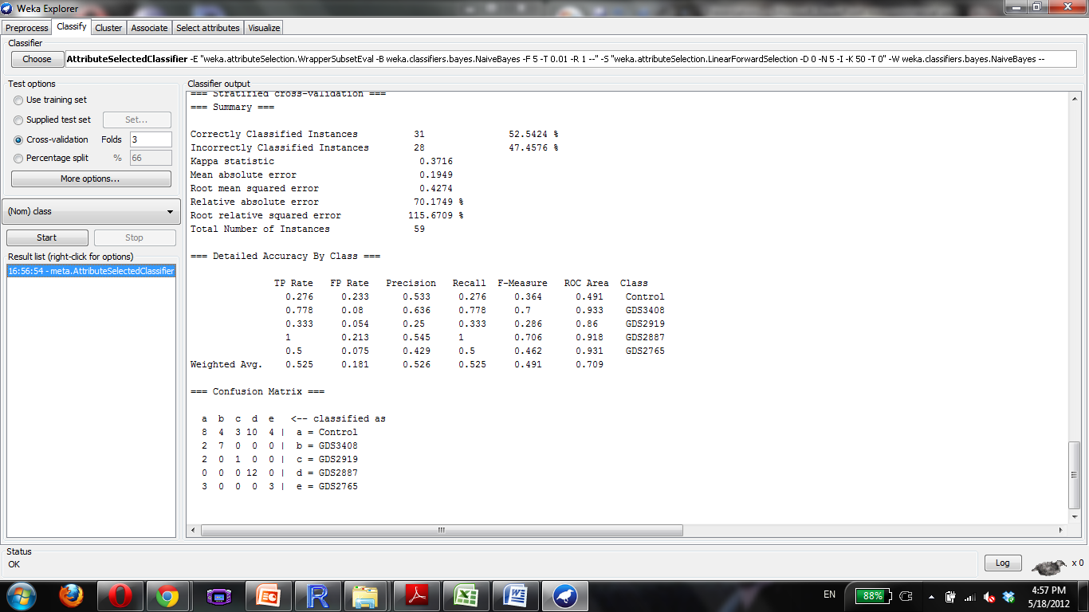

Slide 99
Parkinson Disease
10
GDS3129, GDS3128, GDS2821, GDS2519, GDS2053, GDS2027, GDS1641, GDS956

Slide 100


Slide 101


Slide 102
Polycystic Ovary Syndrome
4
GDS3104, GDS2084, GDS1051, GDS1050

Slide 103


Slide 104


Slide 105
Pre-Eclampsia
3
GDS3467, GDS2548, GDS2080

Slide 106
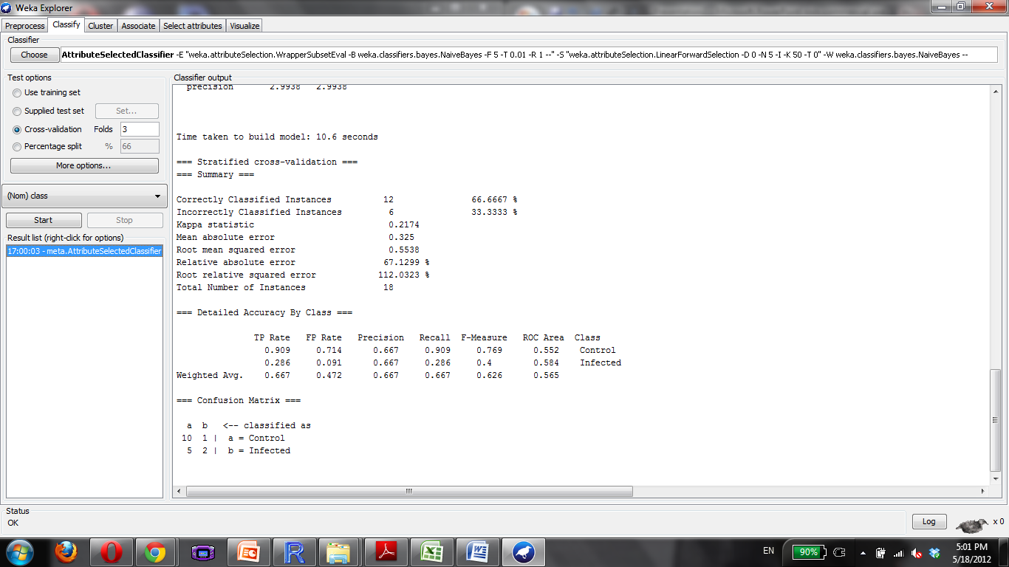

Slide 107
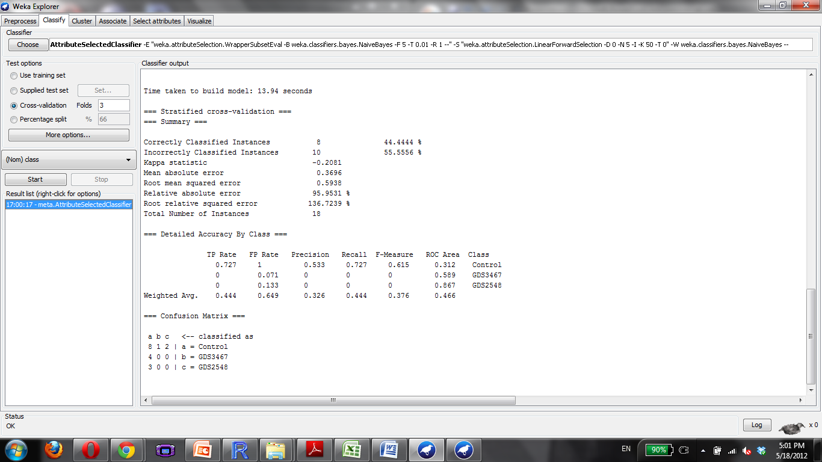

Slide 108
Progeria
3
GDS3495, GDS1504, GDS1503

Slide 109
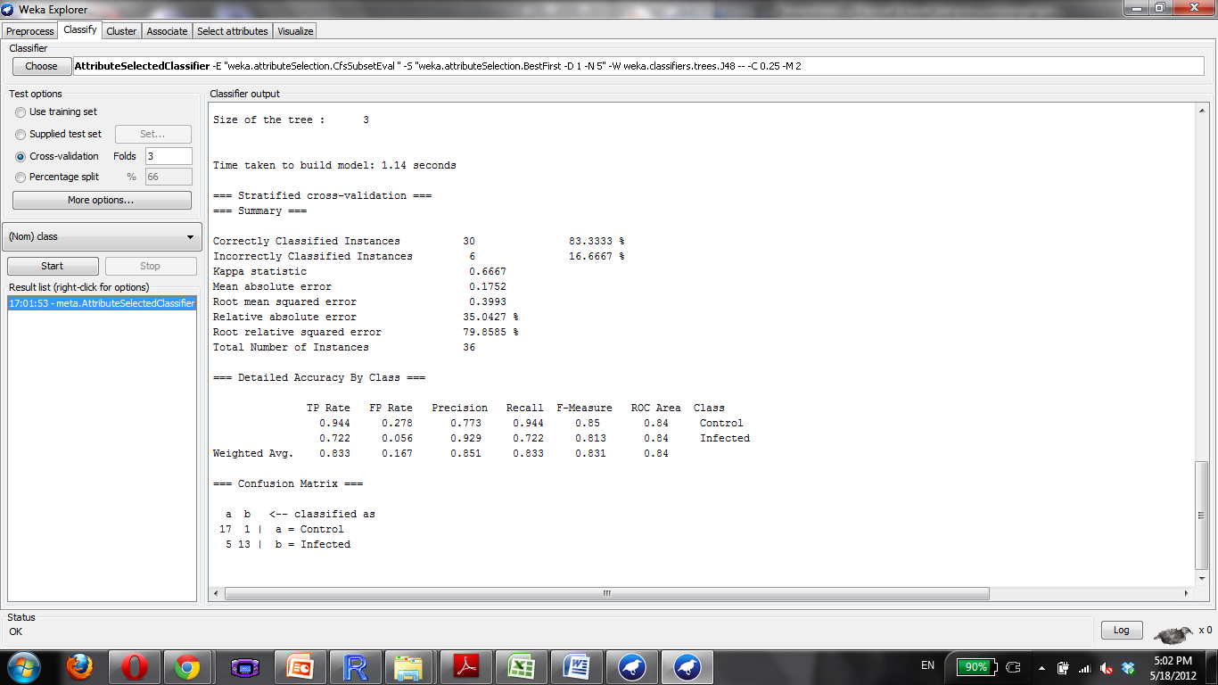

Slide 110
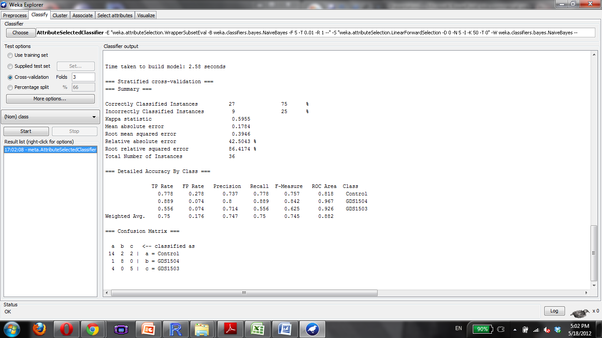

Slide 111
Psoriasis
6
GDS3539, GDS2611, GDS2518

Slide 112
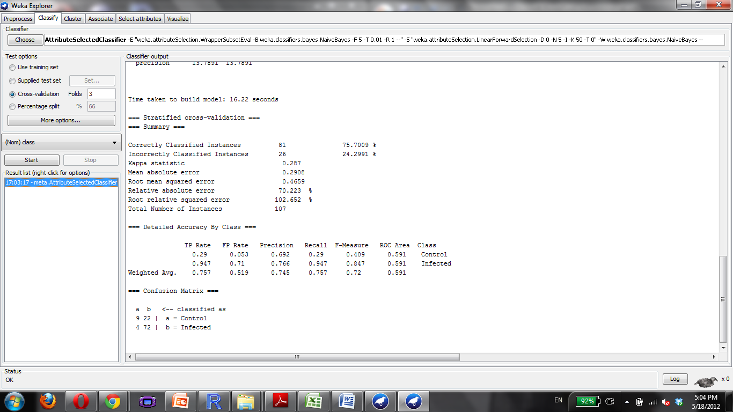

Slide 113


Slide 114
Pulmonary Disease
27
GDS3705, GDS3483, GDS3356, GDS2866, GDS2143, GDS2142, GDS1673, GDS1436, GDS1304, GDS1252, GDS737, GDS534, GDS289, GDS251, GDS240

Slide 115
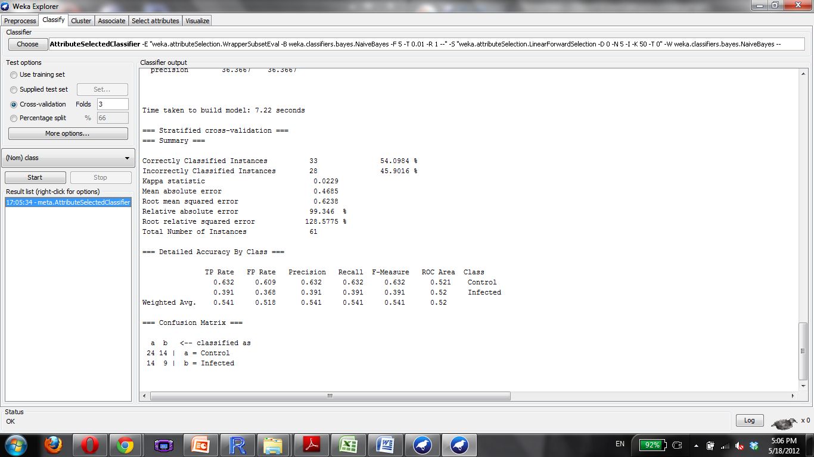

Slide 116


